Slide 1






Ignite the spark, reveal the champion
24th September 2024
Supporting Year 1 Children
Parent Workshop
Hosted by
Ms. Akande, Ms. Artis, Mr. Benham

Slide 2
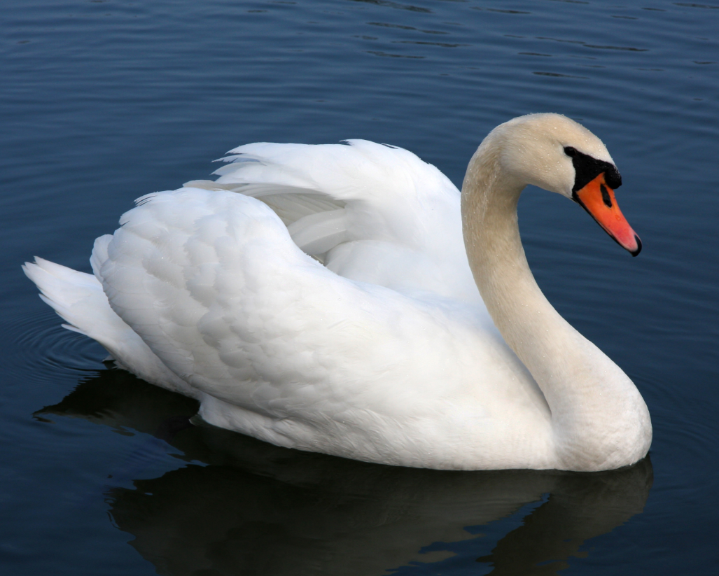
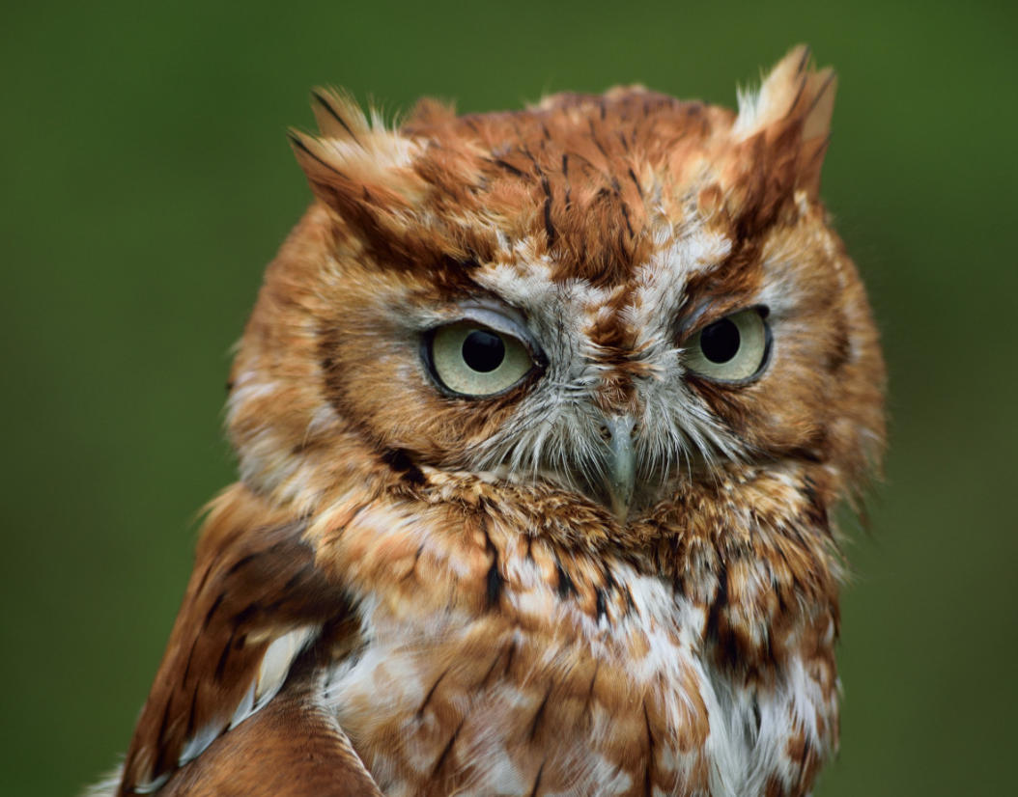
Meet the team
Ms Akande
Swan’s Class
Mrs. Taylor
Year 1 TA
Mr Benham
Digital Learning Lead

Slide 3

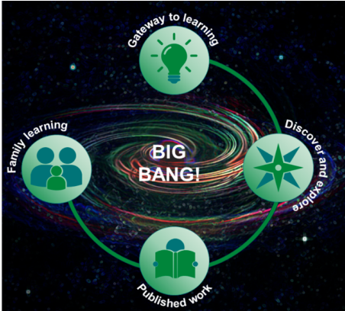

Learning in Year 1 - Topics
Autumn 1 | Autumn 2 | Spring 1 | Spring 2 | Summer 1 | Summer 2
Magic Beans | Planet Protectors | All Aboard! | Paws and Claws | Fire! Fire! | Shiver me Timbers
Core Texts as Topic Leaders
Sequential and Iterative Curriculum
Local & Global Perspectives
Engaging & Adaptive Teaching
Big Bangs & Family Learning Afternoons
Notes:
Each topic is driven by high-quality core texts that link subjects together. This approach helps children make meaningful connections across subjects, deepening their understanding and engagement.
Is carefully mapped out to ensure learning is progressive and builds on previous knowledge. By reinforcing learning with trips, visitors, and special events like Big Bang Days, children develop contextual and purposeful links throughout their primary education.
The curriculum emphasises learning about the local area of Greenhithe, its history, and its geographical importance, while also encouraging students to understand how their community connects to London, the wider UK, and the world.
We develop medium- and short-term plans that are engaging, ambitious, and inclusive. The curriculum uses a universal design for learning approach, incorporating adaptive strategies to meet the needs of all students.
Each topic begins with a 'Big Bang' event to spark curiosity and ends with a Family Learning Afternoon, where students share their work. The children's own perspectives on what they want to learn (gathered through 'gateway to learning') guide part of the topic, ensuring that their interests are reflected in the learning process.

Slide 4

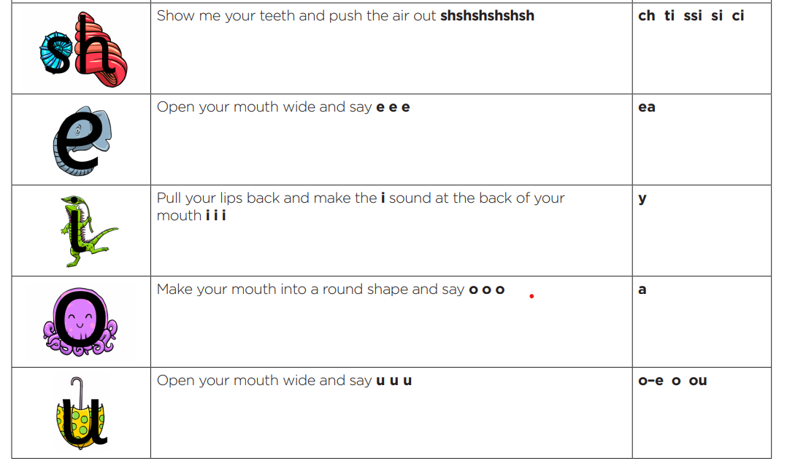
Learning in Year 1 - Phonics
Children will continue their Phonics learning from Reception
Moving on to Phase 5 phonics which is the final stage
Children will learn alternative graphemes for sounds learnt in Phases 2 and 3
They will continue to apply this knowledge to their reading and writing
Notes:
Little Wandle Letters and Sounds: a complete systematic, synthetic programme.
• 20 minutes lessons, taught daily by class teacher
• 4 new sounds taught each week, with consolidation on Friday.
• Assessed each half term

Slide 5
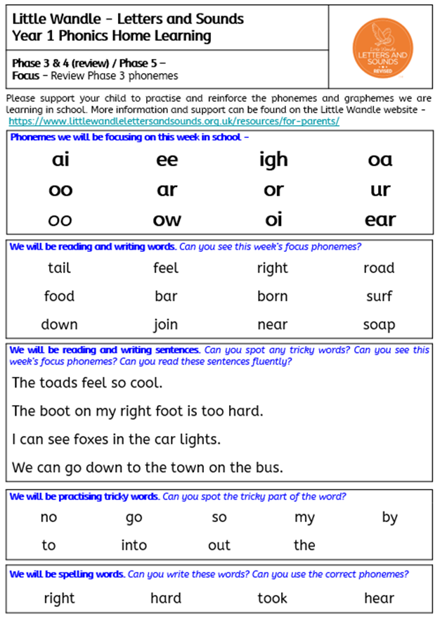
Learning in Year 1 - Phonics
For further advice on how to support your child at home, please visit the Little Wandle website and view their section for parents.
https://www.littlewandlelettersandsounds.org.uk/resources/for-parents/
Notes:
Little Wandle Letters and Sounds: a complete systematic, synthetic programme.
• 20 minutes lessons, taught daily by class teacher
• 4 new sounds taught each week, with consolidation on Friday.
• Assessed each half term

Slide 6
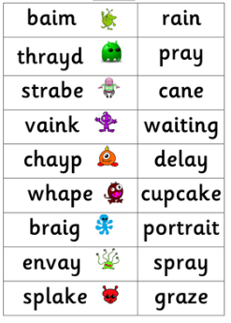
Learning in Year 1 - Phonics
In the Summer term Year 1 children will take a phonics screening check.
It will consist of 20 real words and 20 alien words
It will check segmenting and blending skills.
There is no pressure put on the children for this test. All that can be done is practice reading so that they feel confident!
Notes:
The pass mark is usually 32 but this does sometimes change
If children do not pass they will re-take it in year 2

Slide 7
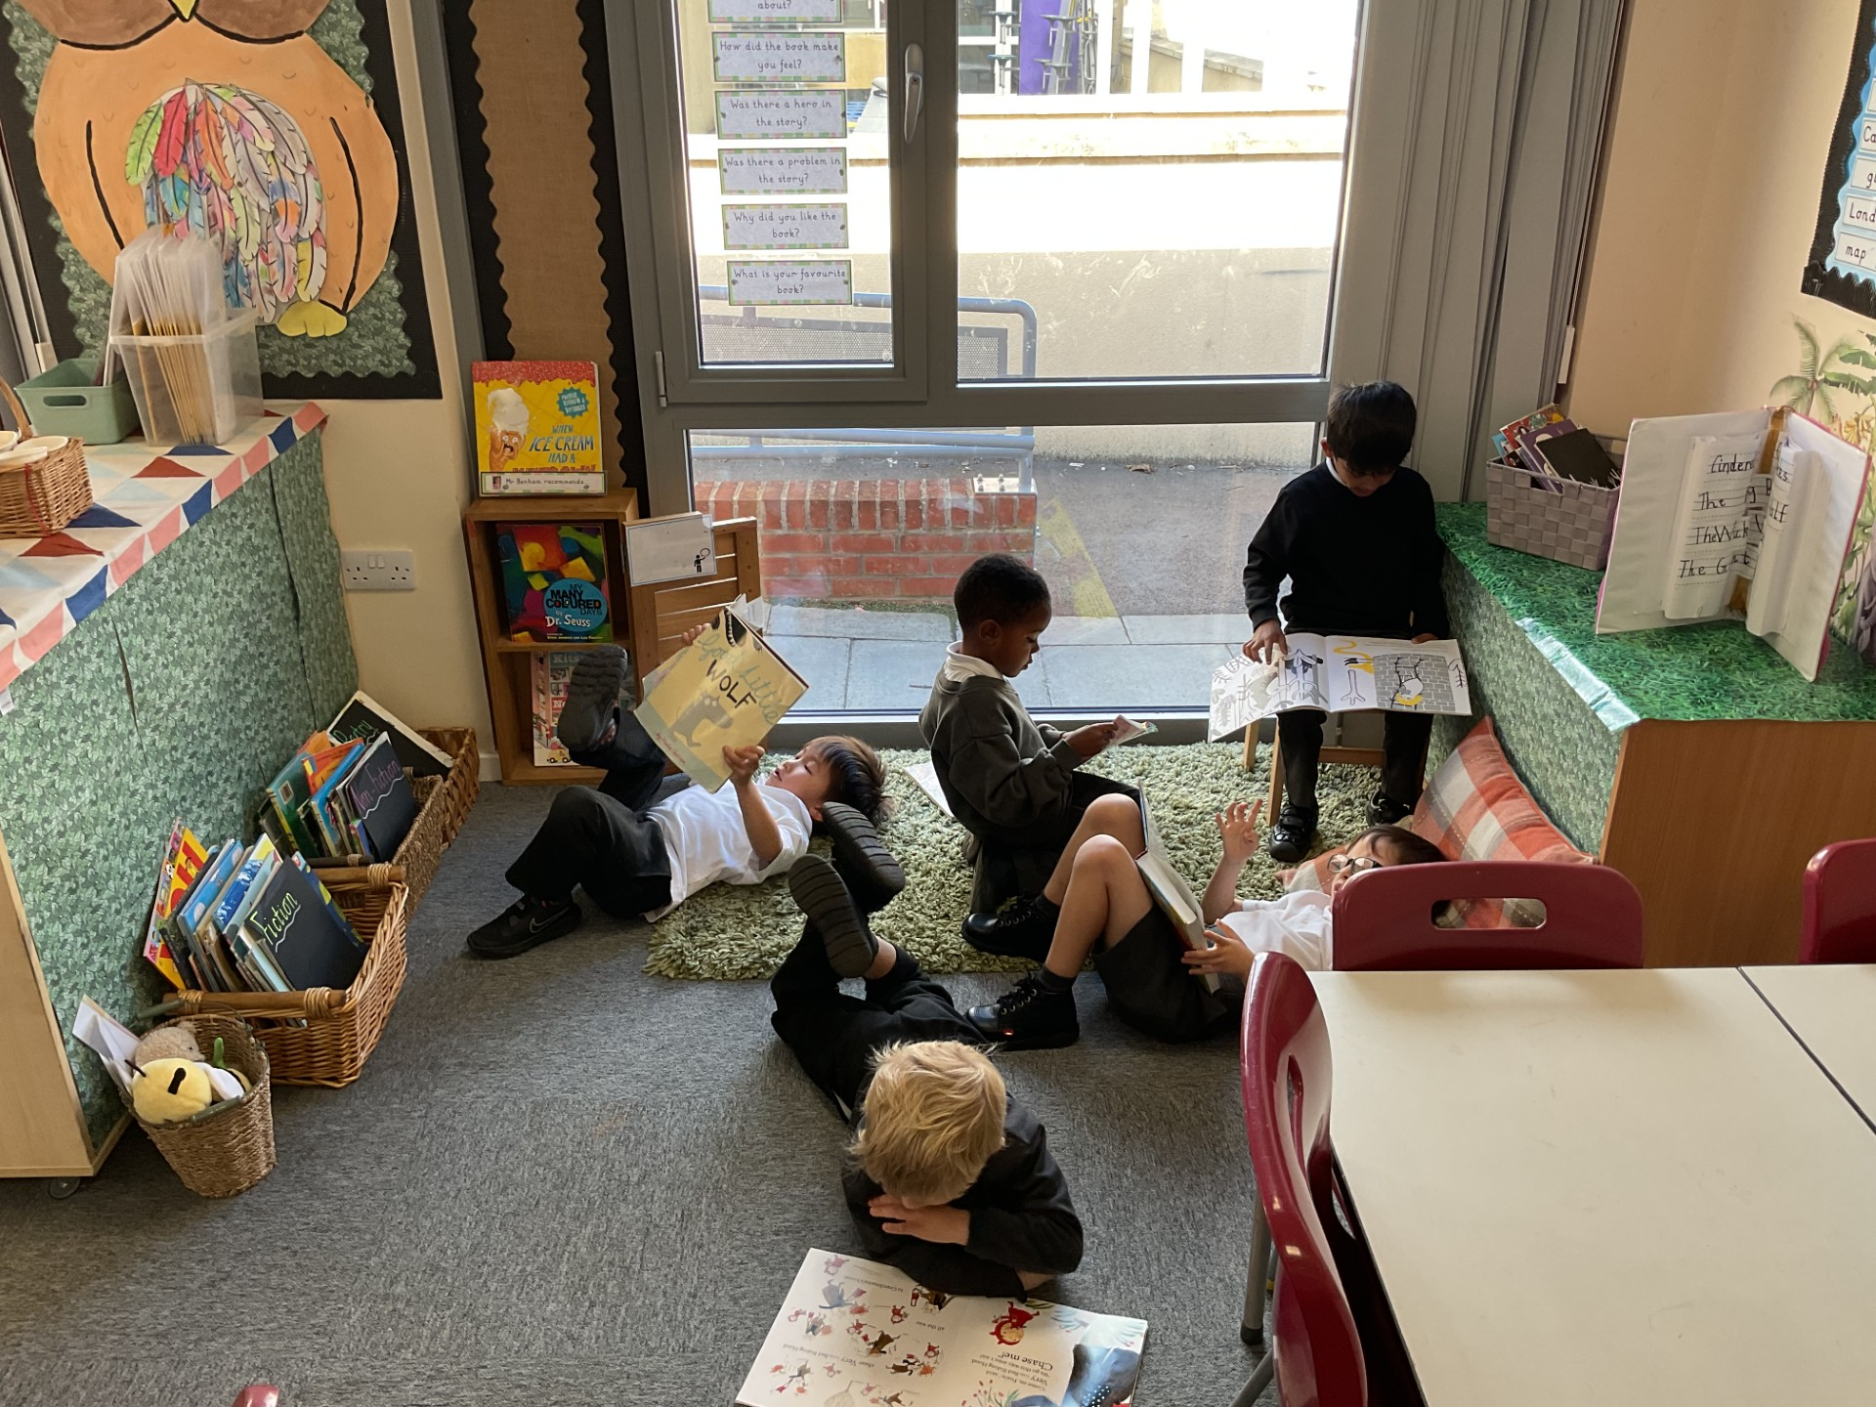
Learning in Year 1 - Reading
Phonics & Early Reading
Reading Schemes
Reading for Pleasure
Expectation that all children are read to every night for at least 20 minutes
Notes:
We foster a love of reading by providing well-resourced libraries and book corners, aiming to create a community of readers. This includes an emphasis on reading for enjoyment and developing a lifelong reading habit.
Children will have the opportunity to visit their school library once a week and select a book to take home. This book as well as one guided book that has been selected by child’s class teacher according to their phonics level.
Please ensure that your child brings their bookbag with books and reading record to school everyday so that children’s reading can be monitored by their class teacher and if they read with an adult at school, their progress can be logged in their reading record book

Slide 8

Learning in Year 1 – Reading
When reading with your child at home try…
- Asking questions about the book – Can they make predictions? Why do they think that? How are the characters feeling? Are there any clues? Can they retell the story? Who is their favourite character and why?
Talk about some of the sounds they can see, e.g. diagraphs,
trigraphs and tricky words they can spot.
Notes:
It is important that when you read with your child at home it is a positive experience. Keep it fun! To encourage reading for pleasure make sure that you are also taking time to read stories to children. This also helps to support children in developing their fluency and learning new vocabulary.

Slide 9
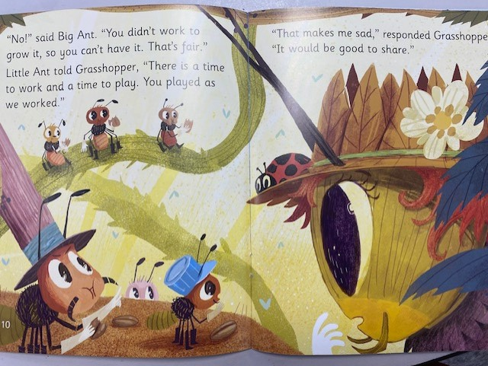
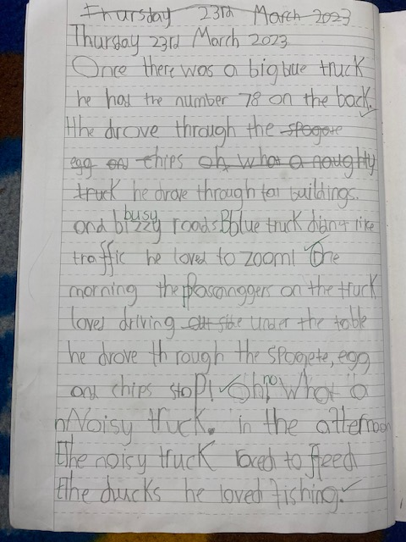
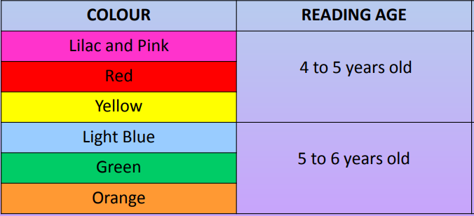
End of KS1 Expectations

Slide 10
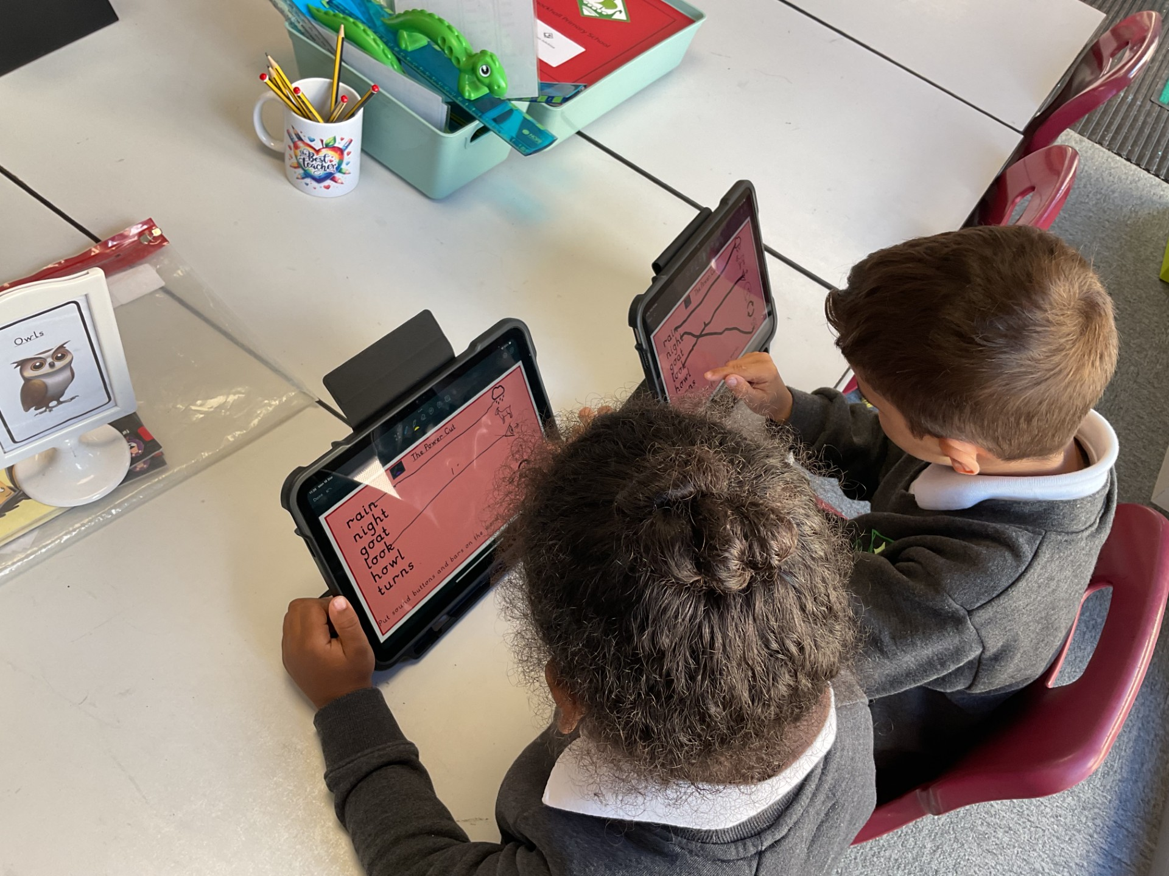
Technology in the Classroom
From Year 1 all children are allocated an iPad to support them with their learning throughout the school day.
Notes:
JB to discuss expectations and use

Slide 11
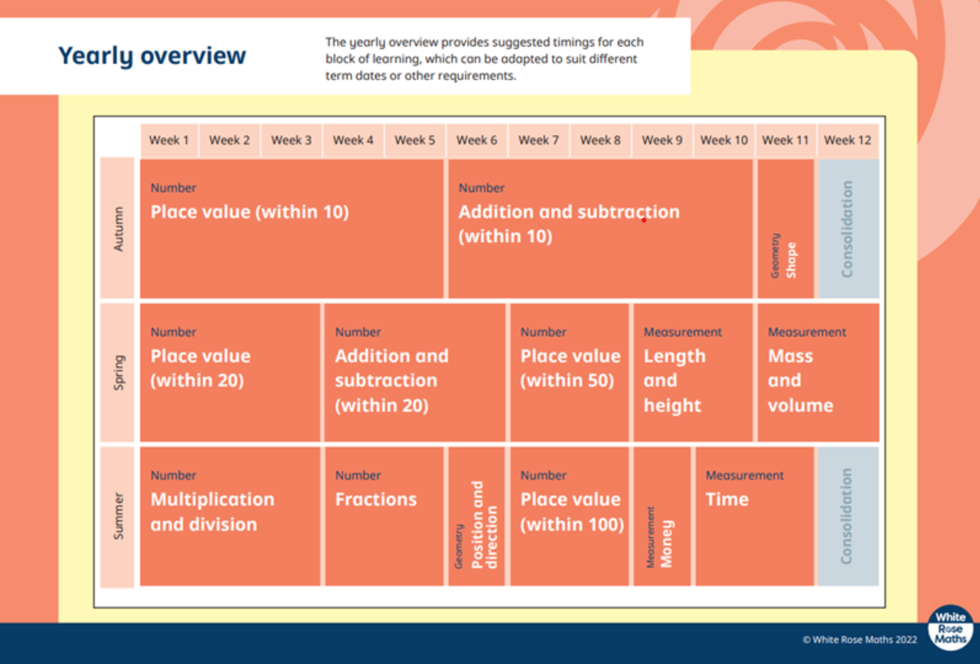
Learning in Year 1 - Maths
Mastery Approach to Maths
Coherence
Representation & Structure
Fluency & Variation
Encouraging Mathematical Thinking
Notes:
We aim to develop deep, secure, and adaptable understanding in maths, using the White Rose Maths framework. Mastering maths means that students can apply their learning in various contexts and develop problem-solving skills.
Coherence (Lessons are broken down into small, connected steps providing access for all children and leading to the ability to apply the concept to a range of contexts.)
Children will build upon previous learning moving on from numbers to 10 in Autumn term to numbers to 20 and 50 in the Spring terms
In summer they will begin to learn about multiplication and skip counting numbers in 2s, 5s and 10s

Slide 12
Day-to-Day
Morning Session 1 |  | Morning Session 2 |  | Afternoon Session
Writing Maths Shared Reader (These lessons are taught daily) | Play Time | Phonics Reading (These lessons are taught daily) | Lunch | Maths Meet (daily) Computing x 1 weekly RE x 1 weekly PD x 1 weekly Art / D&T x 1 weekly Music x 1 weekly PE x 2 weekly Science x 1 weekly
Swan’s Class PE days: Tuesday and Thursday
Owl’s Class PE days: Tuesday and Thursday

Slide 13
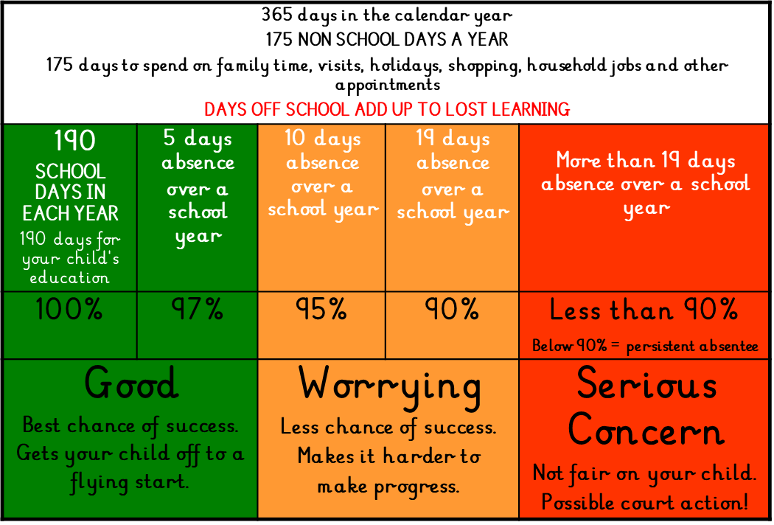
Attendance Matters
Notes:
We encourage regular pupil attendance and punctuality by promoting to parents/carers and children the importance of regular school attendance.
We create a positive, strong ethos of attendance
We are here to support you and help your child make the most out of their time at Knockhall Primary School.
Together we make a difference.

Slide 14

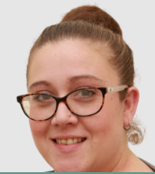

We Welcome Your Feedback!
Class teacher
Ms Artis(Phase Lead)
Mrs Wady (DHTI) / Mrs Riley (DHTC)
Miss Yiannadji (Headteacher)
Notes:
Mention writing

Slide 15

Questions?

