Slide 1
School Council
Monday 3rd October

Slide 2
What is the School Council for?
A school council is a formal group of pupils who act as representatives of their classmates in discussing school issues with the headteacher and staff. It’s a brilliant way of representing and contributing to Pupil Voice in your school. Students are elected to represent the views of all pupils and also to improve their school.

Slide 3
What is required to be in the school council?

Slide 4
You will meet with your head of house once per term and Mrs Riley once per term
You need to gather information and feedback from your friends.
The School Council will feedback to the whole school at the end of each half term in assembly.
We will discuss the following:
Digital learning and e-safety
Wellbeing
Clubs and Children’s University
Being and promoting being active
Safe travel
Rainbow - inclusivity

Slide 5
How will our school council look?

Slide 6
SCHOOL COUNCIL
Mrs Riley
HEVER
Miss Shergill
ROCHESTER
Mrs Moss
LEEDS
Mr Adekoya
DOVER
Mrs Franks
Year 1 rep
Year 2 rep
Year 3 rep
Year 4 rep
Year 5 rep
Year 6 rep
Year 1 rep
Year 2 rep
Year 3 rep
Year 4 rep
Year 5 rep
Year 6 rep
Year 1 rep
Year 2 rep
Year 3 rep
Year 4 rep
Year 5 rep
Year 6 rep
Year 1 rep
Year 2 rep
Year 3 rep
Year 4 rep
Year 5 rep
Year 6 rep

Slide 7
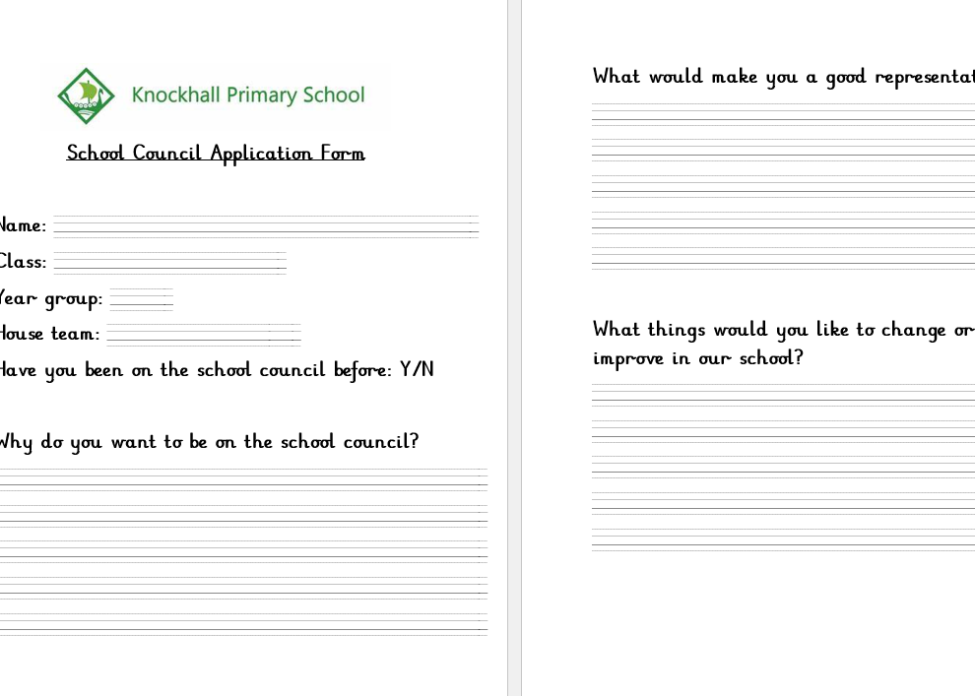
How can you get involved?
1) collect an application form from your class teacher

Slide 8
How can you get involved?
2) Complete the application form and give it to Mrs Riley

Slide 9
How can you get involved?
3) Speak to your friends and peers to tell them why you would be a good representative – they will be voting for the representatives.

Slide 10
When do you need to apply by?
You must give your applications to Mrs Riley by Friday 14th October! That’s 2 weeks time.

Slide 11
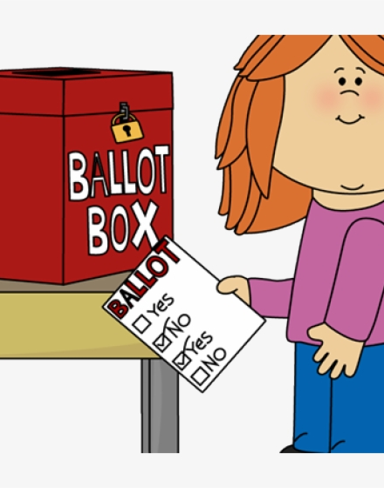
When will we vote?
Thursday 20th October

Slide 12
The School Council will be announced on Monday 31st October
The first day back after half term.

Slide 13
Any questions?

