Slide 1
Reading Plus
15th October 2024
Mrs Benfield
Teaching and Learning Lead
October 2024
Teamwork Respect Honesty Pride

Slide 2
What is Reading Plus?
Reading Plus is a programme for children aged 6 and above that teaches them to be stronger readers. It does this by developing silent reading fluency (reading speed), then introducing more complex stories
(for comprehension), and advanced vocabulary (for knowledge).
Children have access to over 1,000 high quality, varied online texts that are constantly updated and adapted to meet every child’s needs, regardless of what level they are reading at. Teachers can monitor exactly what and how children are reading, meaning they can offer the right kind of support when needed.

Slide 3
How does it work?
Children choose a story (typically 6-7 minutes in length) from a level appropriate to their reading ability. Once they finish the story they answer 10 questions to test if they understood what they have just read. The questions can be asked throughout the story, not just at the end.
Teachers can see reports detailing your child’s progress. Worksheets are available for extra support with specific reading skills if needed. Reading Plus is not meant to replace reading books, and Reading Plus is not just an eLibrary - the programme is designed to teach your child to become a more efficient reader which will add to their enjoyment of reading independently - developing a lifelong love for reading.

Slide 4
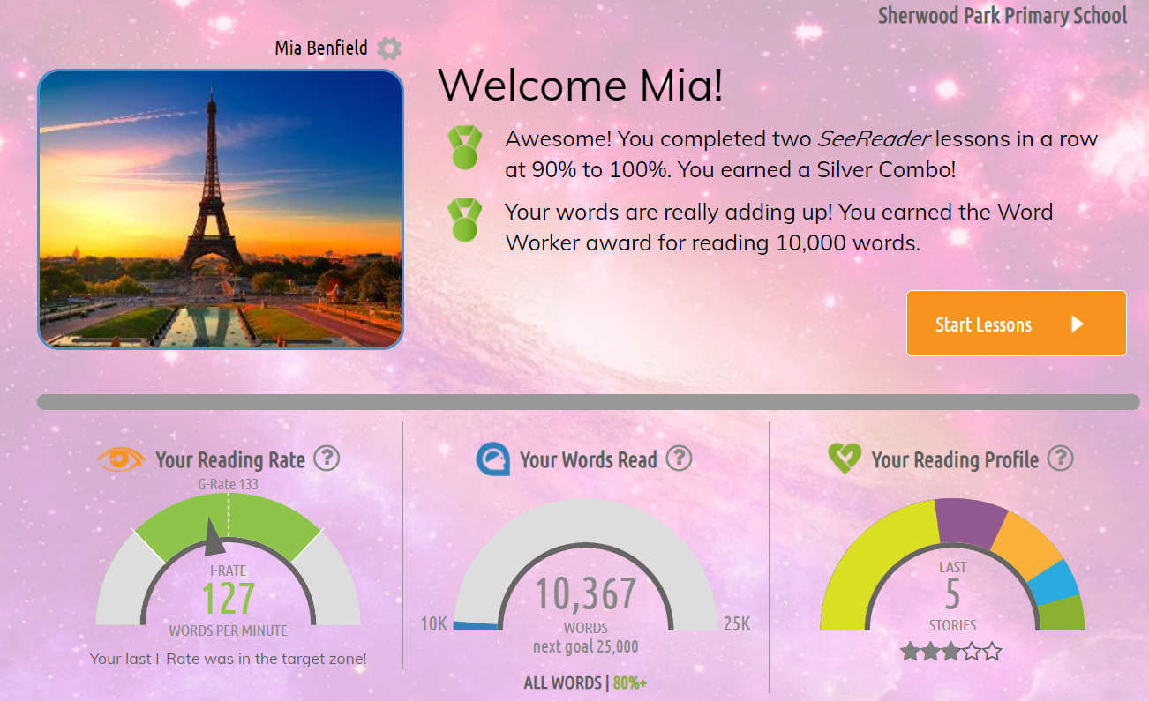

Slide 5
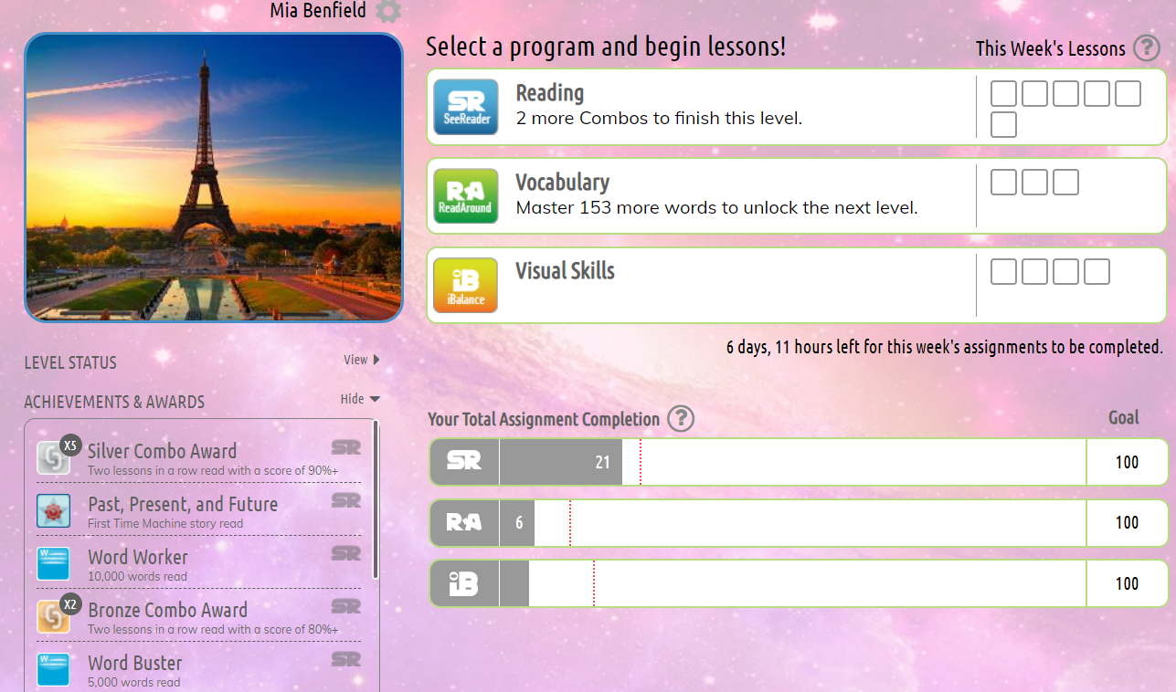

Slide 6
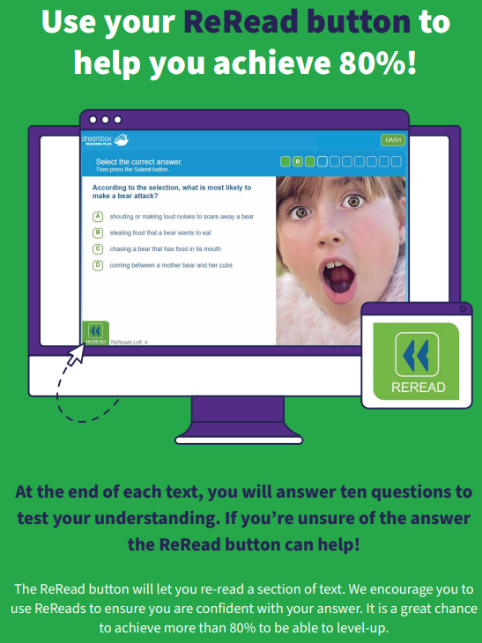

Slide 7
Suggested Homework
Reading Plus
10 minutes, 3 times a week
Years 3, 4, 5 and 6

Slide 8
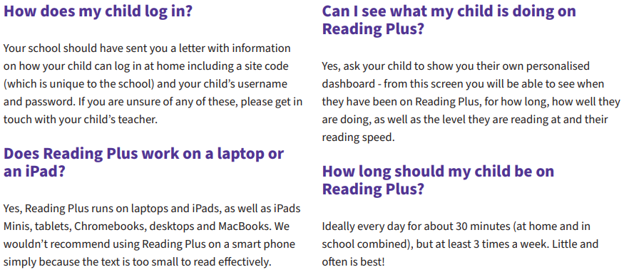
Frequently Asked Questions

Slide 9
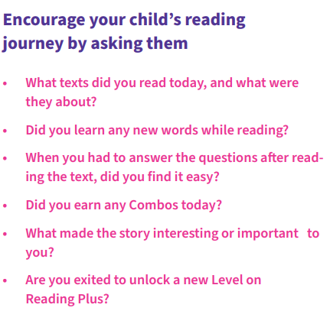
How can you support?

Slide 10
Online Support Videos
Click here for videos and information to support you and your child with Reading Plus at home.
https://www.readingsolutionsuk.co.uk/resource-category/home-use-for-parents-and-pupils/

Slide 11
Questions
Mrs Benfield

