Slide 1
Ignite the spark, reveal the champion
2024-2025 intake
Welcome to
Knockhall Primary School
Knockhall Primary School
TEAMWORK RESPECT HONESTY PRIDE

Slide 2
Meet the Staff
Miss Yiannadji – Head teacher
Mrs Riley, Mrs Wady and Miss Allen – Senior Leadership Team

Slide 3
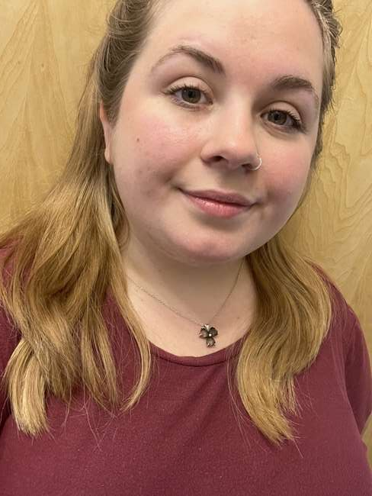
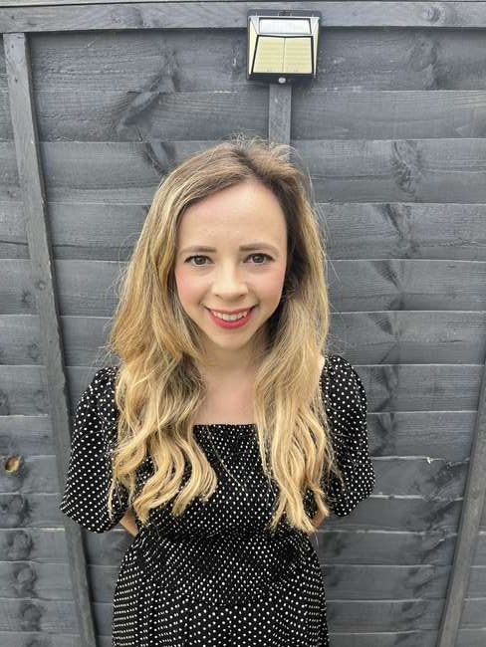
Meet the class teams
Nursery (Ducklings) – Miss Taylor
Reception –
Owlets – Miss Shergill
Cygnets - Mrs Journet

Slide 4
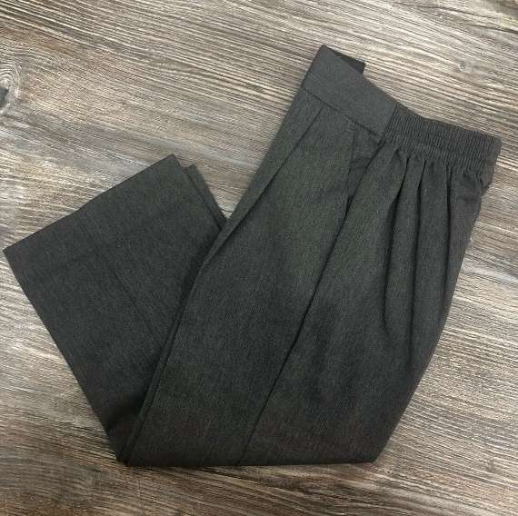
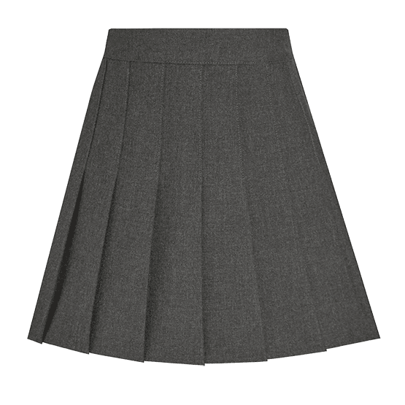
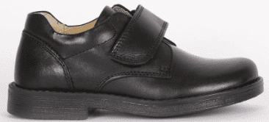
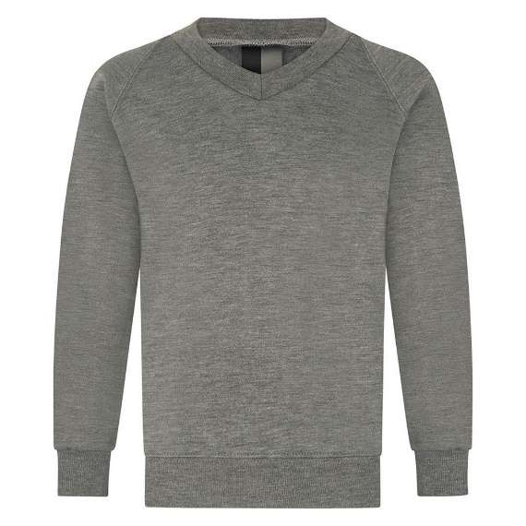
What will your child need?
Uniform:
Grey cardigan/ jumper
White polo shirt
Grey trousers/ skirt
Black shoes
Small Book bag (ideally not a back pack)
Green gingham dress (optional in Summer)
Spare clothes in the bags in case a change is needed (this does not have to be uniform)
EVERYTHING MUST BE CLEARLY LABELLED WITH YOUR CHILD’S NAME

Slide 5
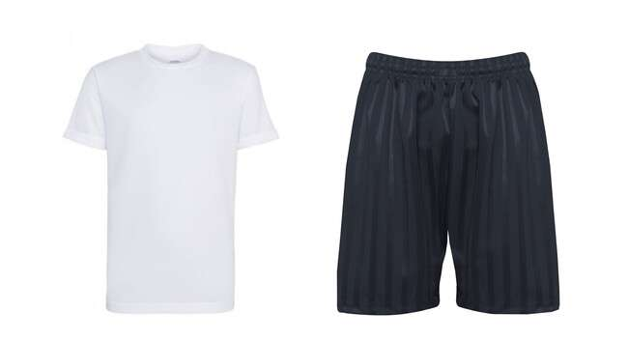
What will your child need?
Reception only
PE kit:
White t-shirt
Black trainers
Black tracksuit for winter/ shorts for summer
PE days will be communicated with you, children come into school already dressed for PE.
EVERYTHING MUST BE CLEARLY LABELLED WITH YOUR CHILD’S NAME

Slide 6
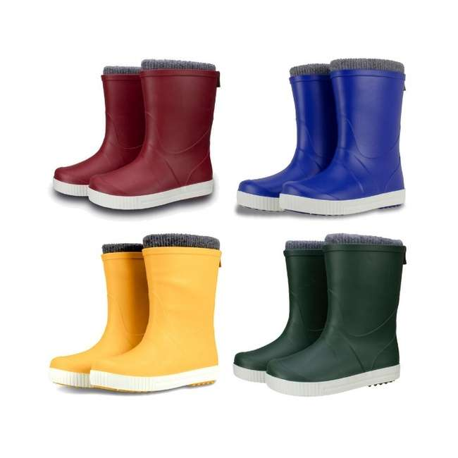
Forest School
Out vast grounds consist of a wooded area where children attend weekly sessions in the natural environment Forest School
Forest school is a holistic approach to learning, where children explore the woodland setting and engage in exciting activities. These include:
Tree climbing
Digging
Mud kitchen
Using tools safely
Bug hunting
Knots and lashings
Shelter and den building
Your child will need their own waterproof onesie and a pair of wellies
which will be kept in school
Notes:
Embracing technology to support children’s learning and our engagement with parents within our school community
Using Showbie to record children’s achievement in EYFS and, as children progress through school, combining this as a powerful tool in class alongside working in books and on paper
For some children, this will be a means of removing a barrier to learning and for others an alternate outlet for a means of recording
Teachers are also sharing the digital journey and many members of staff have already achieved their Apple Teacher status! Children have access to iPads in classes, for the majority of children in school this is 1:1

Slide 7
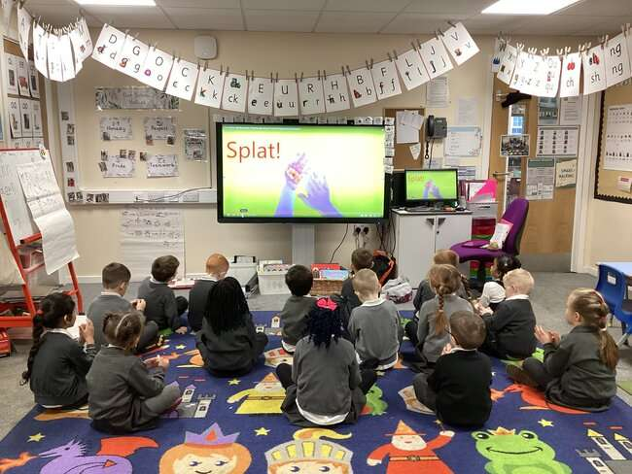
What does the curriculum look like?
The Prime Areas are:
Personal, Social and Emotional Development
Physical Development
Communication and Language
The Specific Areas are:
Literacy
Maths
Understanding the World
Expressive Arts and Design

Slide 8
Our approach to Phonics
Children are taught using a scheme called Little Wandle Letters and Sounds, more information will follow. There is a daily phonics session throughout the school and children are regularly assessed to identify any gaps in learning.
Reception parents - You will have the opportunity to borrow flashcards to support your child at home and these will be available on Showbie too
All children take home reading books daily. These will be wordless books at first which the adults selects, progressing to books that match reading level. Children also chose their own story, a book for pleasure – details of a Phonics workshop will follow in the Autumn term
Books are changed on Fridays

Slide 9
Transitions - Reception
Home visits will be carried out over 5th and 6th September (times are within the welcome packs)
September dates:
Monday 9th September and Tuesday 10th all children to begin school, children will attend, either for morning session (8.40-11.30) or for the afternoon (12.30-3.20)
Wednesday 11th September – all children all day 8.40-3.20
https://assets.publishing.service.gov.uk/media/64f5e8b29ee0f2000db7be4f/2023_Information_for_parents_reception_baseline_assessment_WEBHO.pdf
Notes:
Baseline assessment

Slide 10
Transitions - Nursery
Home visits will be carried out over 5th and 6th September (times are within the welcome packs)
September dates:
Monday 9th September onwards all children are welcome to attend for the full hours of their sessions (either 15 or 30 hours). Please discuss if you feel your child may need a more phased start to the nursery
If your child attends for 15 hours times are: 8.30-11.30 or 12.30-3.30
If your child attends for 30 hours times are: 9.00 – 3.00
Notes:
Baseline assessment

Slide 11
Transitions
Transition day Monday 8th July 9.45-10.45
An opportunity for you to visit with your child so they can see their classrooms, meet the teachers and experience their soon to be new surroundings.
Teddy Bear’s picnic – bring a bear and a healthy snack
Notes:
Baseline assessment

Slide 12
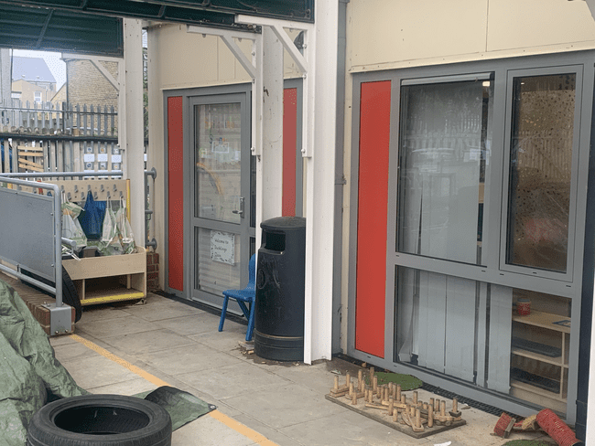
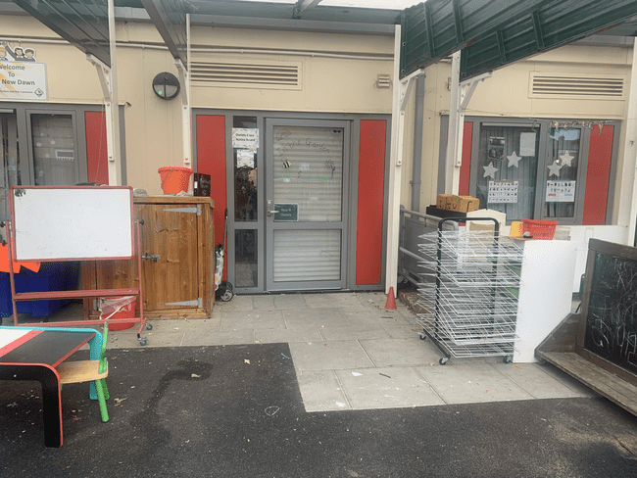
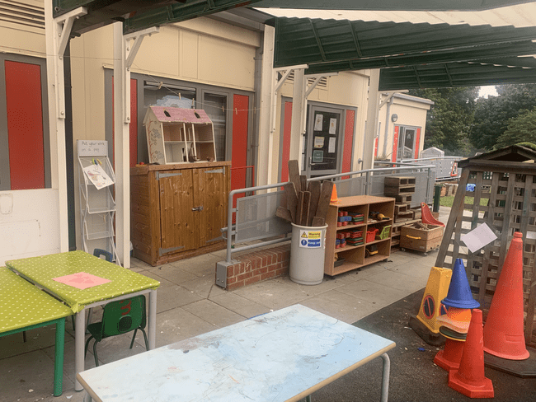
Where will I drop off and collect my child? What time?
Gates open daily at 8.30-8.50 then again at 3.15-3.40
Wait with your child in EYFS outside area until the classroom door is opened
Please inform staff of any changes to the people collecting/ dropping off
Ducklings Owlets Cygnets
Notes:
The EYFS curriculum is play based learning.
Play opportunities are carefully planned for, to develop key skills which children will then continue to practice and consolidate.
Learning is both self-directed and adult led too, where specific children are targeted to activities that meet their needs.
Whole class sessions take place too, including Maths sessions, Literacy and phonics.

Slide 13
What do I do now?
Please return all paperwork to the school office with original birth certificate by
Friday 5th July 2024.

Slide 14
What happens now?
Help your child to prepare by:
Talking to them about their new school and teacher (look at the website for photos and videos)
Recognising their own name
Using a fork for eating
Going to the toilet independently
Getting dressed and undressed independently
Carry their own belongings
Follow simple instructions
Deciding whether your child will have a packed lunch or school meal
Natasha’s law (food in original packaging so that all are aware of allergens)
Download Showbie on your phone (this is iOS only but can be accessed via web browser too)
Look out for the invitation to create an account for The Pantry to order lunches (Nursery will need to pay for these)
WRITE NAMES ON EACH ITEM OF CLOTHING

Slide 15
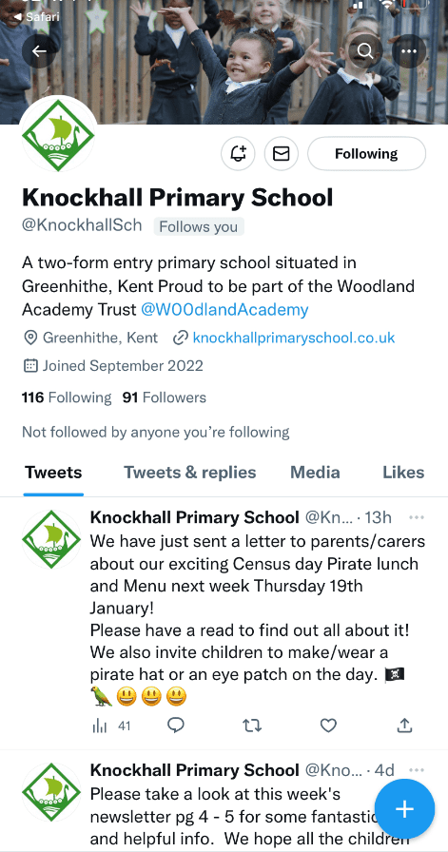
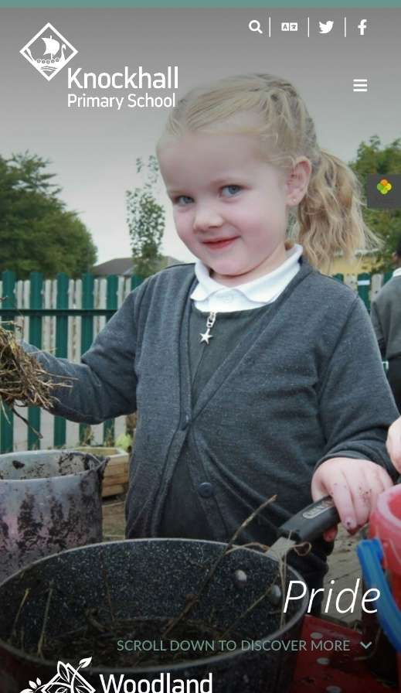
School website and social media
Please visit our school service for further information
https://knockhall primary school.co.uk
Part of the Woodland Academy Trust

